Slide 1
Teaching Experience Enhancing Academic Skills Internship Presentation
My 28-Day Internship at Shivappanna Gundali Kannada Medium School, Hebbal

Slide 2
Acknowledgement
I extend my sincere thanks to Shivappanna Gundali Kannada Medium School for the invaluable 28-day internship opportunity. Grateful to the school administration, teaching staff, and students for their warm welcome and cooperation.
Special appreciation to Mrs. Seema Malaani, the Principal, for her permission and constant support. Acknowledging the dedicated teaching faculty for their guidance and expressing gratitude to the 4th and 5th standard students for their active participation and enthusiasm.

Slide 3
Executive Summary
Thanks to everyone involved in the success of the internship.
Objectives focused on enhancing students' understanding academic Hindi , academic English and Maths .
Active engagement with students through daily teaching sessions in an interactive and participative manner.
Emphasis on creating a positive and inclusive learning environment.
Reflection on personal and professional growth.

Slide 4
Introduction
The internship took place at Shivappanna Gundali Kannada Medium School, known for its commitment to providing quality education.
Mission and vision of the school: Empowering students with knowledge, integrity, and a sense of responsibility for a future of academic excellence and societal contribution.

Slide 5
Concepts Taught :
1. Hind:
13 स्वर (वाउवेल्स) और 36 व्यंजन (कॉन्सोनेंट्स) का परिचय।
शब्दों का रचना।
एकवचन बहुवचन
2. Academic English:
English Literature (poems and stories )
English Grammar
Writing Letter (formal and informal)
Writing essay
3.Mathematics:
Algebra
Number System

Slide 6
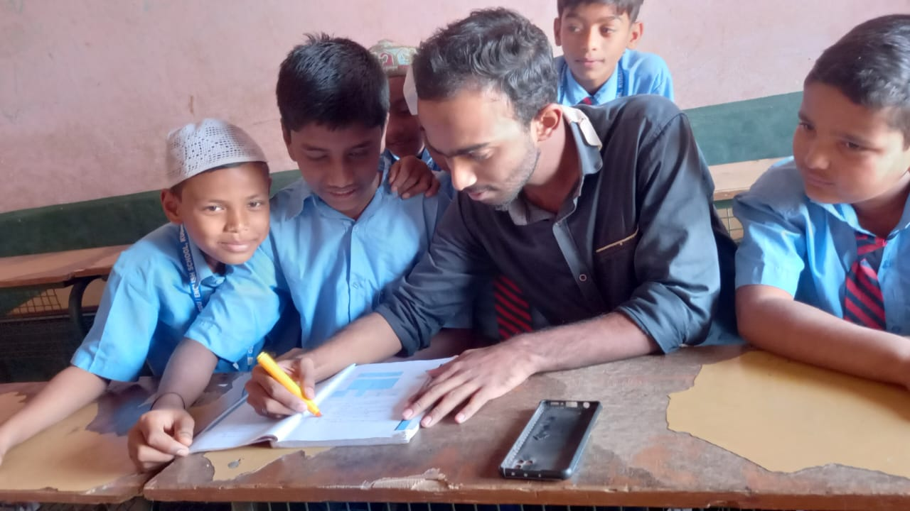
4. Practical Application Exercises:
Hands-on Activities
Collaborative Projects
5. Continuous Assessment and Feedback:
Regular Assessments
Individual Feedback Sessions
6. Interactive Learning Environment:
Engaging Discussions
Q&A Sessions
Wrap-up and Recap Sessions
After class pic on the last Day

Slide 7
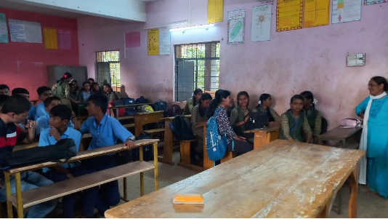
Some Moments from Internship:
Mam, helping us out to know each other.

Slide 8
Challenges Faced:
Diverse Learning Needs: Encountered varying levels of academic proficiency among students, requiring personalized approaches.
Time Management: Managed the limited time available for each session, balancing content delivery with interactive activities and assessments.
Technical Glitches: Faced challenges specially due to language barrier many things I was not able to make them understand because of my accent.

Slide 9
Challenges Faced:
Maintaining Engagement: Worked to sustain student engagement throughout the sessions, especially during when students were not knowing the word in english .
Individual Student Attention: Faced the challenge of providing sufficient attention to each student in a diverse classroom setting.

Slide 10
Conclusion:
In summary, my 28-day internship at Shivappanna Gundali Kannada Medium School has been transformative, enhancing my teaching methods, classroom management, and communication skills. Proficient in educational technology, I navigated challenges with resilience, and collaborative projects emphasized the value of reflective teaching.
Grateful for the school's support, this internship is a pivotal chapter in my educational journey, laying a solid foundation for future endeavors.

